Slide 1
Madison NJ, Morris County storm on November 1st, 2019
A look on a tonoardo in Madison NJ, Morris county storm

Slide 2
tornados
Tornados are rapidly rotating masses of air which are in contact with both a cumulonimbus cloud and the surface of the earth

Slide 3
Types of tonados
land-spout,
multiple vortex tornado
water spout tornado
Notes:
The different types of tornados are the land-spout, multiple vortex tornado and the water spout tornado. waterspout tornado are characterized by having spiraling funnel shaped air currents which link a large cumulonimbus cloud. Lanspouts tornado form at the growing stage of a cumulus congestus cloud while the multiple-vortex tornado has sub-vortices which revolve round as a major component of the main vortex of a tornado

Slide 4
How tornado occur
Components for a tornado to occur
Warm air
Cold air
Notes:
Warm air in this area collided with cold air. The denser air was pushed over the warm air. This resulted to thurdrstorms . An updraft resulted and then winds started to rotated slowly and then sharply at very high speed.
As the rotation took place, it drew warm air from the moving thunderstorm which lead to increase in its speed. Water droplets results from the mesosyclione and formed a funnel cloud. The funnel continued to grow till it desced from the cloud to the earth’s surface and then to the floor of Madison county.
The difference in pressure resulted to the toranod by this time in there were varying pressure within the united states especially in the morriso county

Slide 5
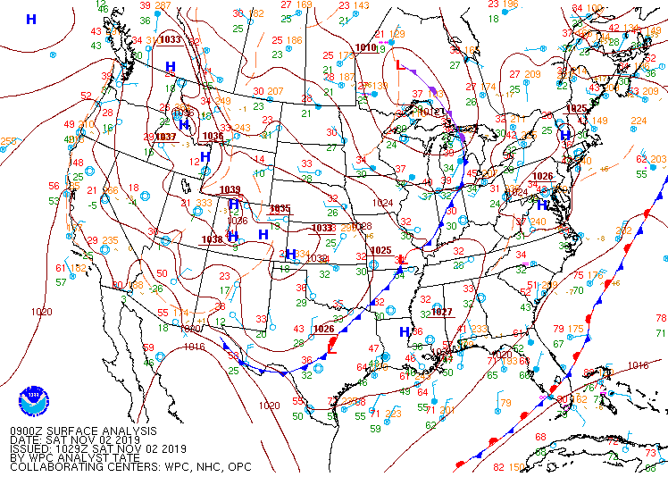
A map representing a tornado on 2nd /11/2019
Notes:
I noticed that there were several storms in the US in the year 2019. There were hurricanes in Barry, Andrea, Dorian and other regions, and this demanded a need for early warnings. Storms, by nature, are destructive. They damage property, destroy infrastructure such as power lines, roads, houses, and people lose their lives also. With a high rate of occurrence, there has been a need to inform the public about them so that people can prepare themselves. Bing a region that is adjacent to the Atlantic Ocean, New Jersey is susceptible to tornadoes which mainly come from the ocean. The Madison NJ, Morris County storm is said to have been predicted by the Weather service earlier (Melisurgo, 2019). The residents had been warned to seek cover since the storm would generate hails and strong wind. Generally, people are advised to go to the basements or any lowest floor until the storm is over. Additionally, they can seek something permanent and avoid windows. The Weather Service had noticed several conditions necessary for the causation of the storm, having analyzed many of them in recent years

Slide 6
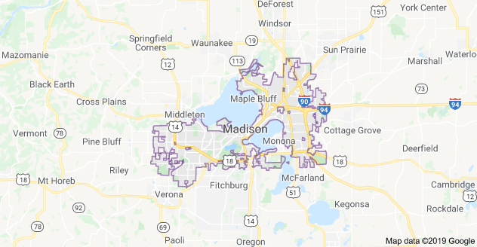
Back ground of our topography
Notes:
Madison county is located in Florida state, it is in the center of its northern neighbor Georgia. It has a total of 813 square mile of which 1.4% is covered with water while the rest is land. In the southern part, it is dominated remnants of Cumberland plateau; the mote sano mountains, keel mountain and the green mountain; in the northern and western parts of the county the land is relatively flat. The difference in elevation of the different parts of the country results currents to blow fro regions of high pressure to regions of low pressure. This facilitated the growth of the tornado of the 2nd November. The county is just adjacent to the ocean hence experiences high levels of humidity.

Slide 7
conclusion
In conclusion, tornadoes studying about tornadoes is of great importance, an individual becomes aware of the different atmospheric occurrences which result to tornadoes. Moreover, one becomes sensitive on following what weather men say when predicting weather. The tornado acts as a good case study. All what happened in Madison is exactly what we learned in class, it acted as a real life situation and much can be deduced form the scene, right from the causes up to the effects as well as measures to undertake to avoid adverse effects which result from a tornado.

Slide 8
references
Work cited page
Melisurgo, L. (2019).Tornado warning issued in 3 N.J. counties. Residents urged to seek shelter. Retrieved from https://www.nj.com/weather/2019/11/tornado-warning-issued-in-2-nj-counties-residents-urged-to-seek-shelter.html

Slide 9
Data analysis
https://www.wpc.ncep.noaa.gov/archives/web_pages/sfc/sfc_archive.php
http://vortex.plymouth.edu/myo/sfc/pltmap-a.html
https://vortex.plymouth.edu/myo/rad/rcm-a.html
http://www2.mmm.ucar.edu/imagearchive/

